Slide 1
Progress Presentation
Home Advantage in Football
A presentation by
Anastasia Hildebrandt
Alexander Kens
Raphael Kleemann Sánchez
Florian Six
TU Berlin
WiSe 2021/22
Programming Project:
Data Science in Python and R
Group D
Notes:
Welcome! So we are back with the Progress Presentation.
We are right now in the research process and we are getting more and more ready for some actual results.

Slide 2
TABLE OF CONTENTS
01
Recap
02
Progress
03
Results
04
Next Steps
What was it again about?
How far did we come?
Anything finalized yet?
What holds the future?
Notes:
First we will refresh your memory on the topic.
Then we will show you the progress that as been made, especially our methods of working with the data. How are we working.
Of course we will share some of our early results. Maybe we already answered the question?
And in conclusion we talk about the next steps.

Slide 3
01
Recap
What was it again about?

Slide 4
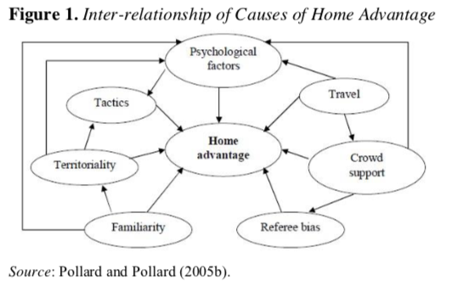
Home Advantage
Alan M. Nevill and Roger L. Holder - 4 main reasons (1):
Crowd
Learning
Travel
Rule factors
Richard Pollard - 10 possible reasons:
Crowd Effects, Travel Effects, Familiarity, Referee Bias, Territoriality, Special Tactics, Rule Factors, Psychological Factors, Interaction of Causes (2)
Relevance:
Fairness
Economy
Away Goals Rule
Notes:
1) Home Advantage - what is that again? It just describes some unspecific advantage when playing on home turf. It exists in many sports and especially in football it has almost mythological character.
Why does it exist? There are many interesting theories as you can see here we put up just two academic directions where
Nevill and Holder found 4 reasons, others like Pollard are more board on the topic and found 10 possible reasons.
But for our research it is not of concern why its happening. Just if it is happening.
Why is it relevant/important?
Fairness, a noble reason
Economy, multi billion industry
Away Goals Rule - a rule based on the assumption of a home advantage got abolished from last season 2020/21 on in UEFA and Bundesliga
Away Goals Rule:
Home away goals Rule:
When 2 teams play each other twice, once at each team’s home ground and it is a tie score wise, the team which scores more ‘away goals’, wins. (4)

Slide 5
RQ to DQ
RQ: Does Home Advantage exist in professional European football?
I. Construct - Home Advantage
II. Construct - Professional European Football
DQ: Do host teams win more than 50% of the equal number of home and away matches in the first leagues of Germany, England, Spain, Italy, France, the Champions and Europa League?
Notes:
We just want to find out if it actually exists and thus we arrive at our RQ:
RQ: Does Home Advantage exist in professional European football?
… which we transformed into the DQ through the 2 constructs Home Advantage and Pro European Football:
DQ: Do host teams win more than 50% of the equal number of home and away matches in the first leagues of Germany, England, Spain, Italy, France and the Champions and Europa League?
We found our Datasets on api-football.com.
continuing now with our current Progress.
..
And their database has 163 countries in 890+ leagues with earliest data from 2008. Now the data for the leagues we have been looking for have data from 2010 on which will suffice for our study.

Slide 6
02
Progress
How far did we come?
Notes:
Now what have we done in the last three weeks?

Slide 7







Tech Stack
Python for writing scripts
imported packages: Pandas, requests, json, Matplotlib, Seaborn
Text hinzufügen
Notes:
Until now we have used different tools that are illustrated on this slide. For example we use python for writing our scripts and have imported different packages like Pandas, requests, json matplotlib and seaborn to support our analyzing process

Slide 8
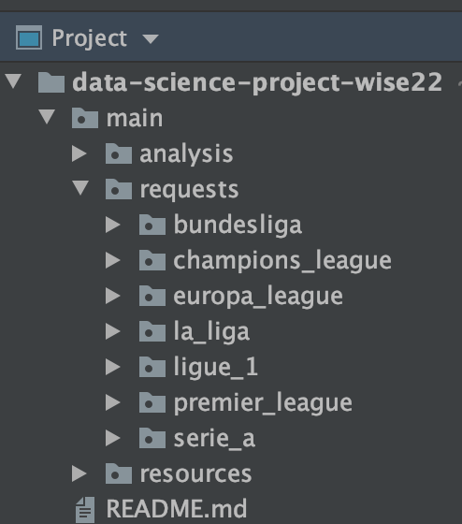
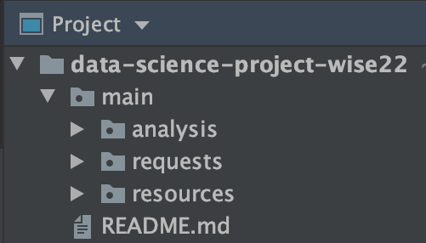
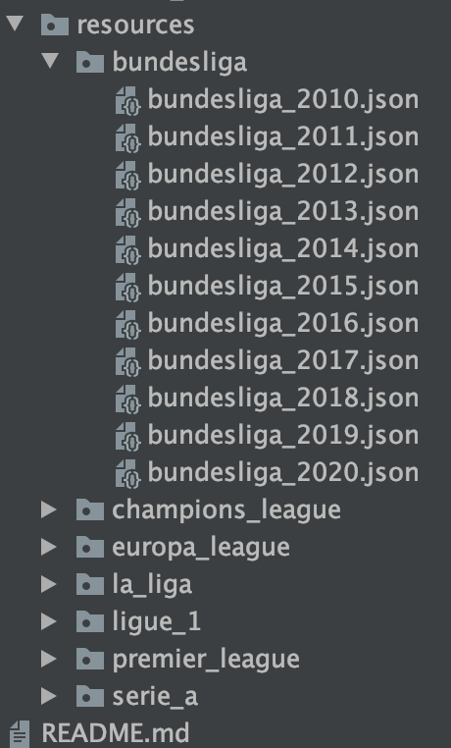
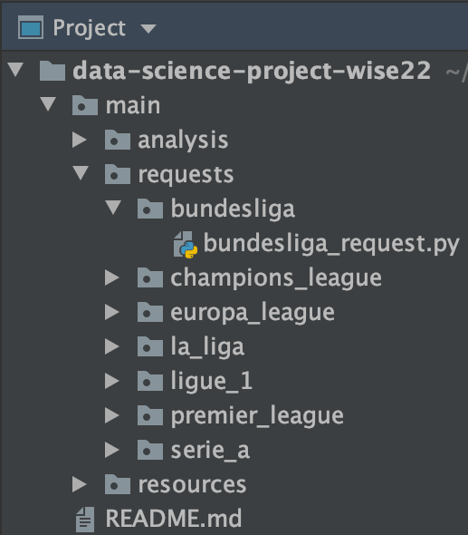
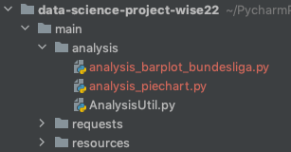
Folder Structure
Requests
Text hinzufügen
single league
Analysis
resources
Notes:
After proposal presenztation first thing we did was to organize our folder structure. We decided to divide it into three parts
the requests and resources folder have the same structure. In each we have a folder for each league. In the requests folder we have saved the python scripts for our requests and in the resources folder we have the json files with the data for each season from 2010 until 2020. And inside the analysis folder we are planing on putting our analysis files and we also have a analysis helper file there, Bur´´ florian will talk about that in a second
First we started by defining a folder structure. We thought that it would be good to divide our project in three parts. The First folder that we created was the Requests folder. In there is one folder for each league with a python file. This file is used to retrieve the data from the API and save a json file in our resources folder. The structure here is the same as in the request folder. Each league has its own folder with the data saved from 2010 to 2020 in jason files. And in the analysis folder we want to put all our analysis files. We also have a Analysis Helper file Analysis Util in there and we will talk about that in a minute

Slide 9
Process
API-Requests
Resources
Clean Data
Python
JSON
Dataframe
Get-Requests were made according to api-football
each League has its own folder with all the seasons from 2010 till 2020
used was the self written class AnalysisHelper to transform the JSONs into Pandas Dataframe/Series
Notes:
Ok so what have we done to process our data. Like told in previous presentation, we got all the data via http requests from our API and stored the data into json files. During this process we noticed, given json format was very nested and hardly manageable. Therefore we wrote a method in a helper class, that contains several other helpful methods for our analysis, that reads the json and eventually returns a clean and flattened dataframe. A script then used this method to store each and every fixture of each and every league and season into one big .csv file. Thats being used in our analysis.

Slide 10
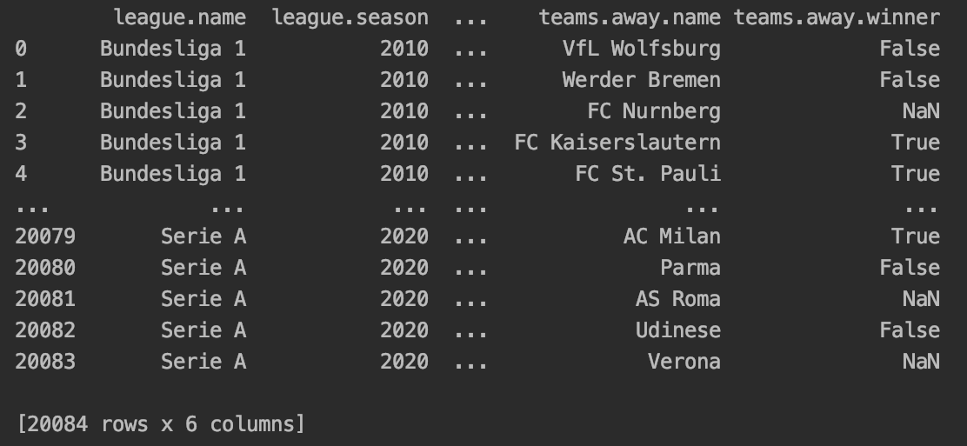
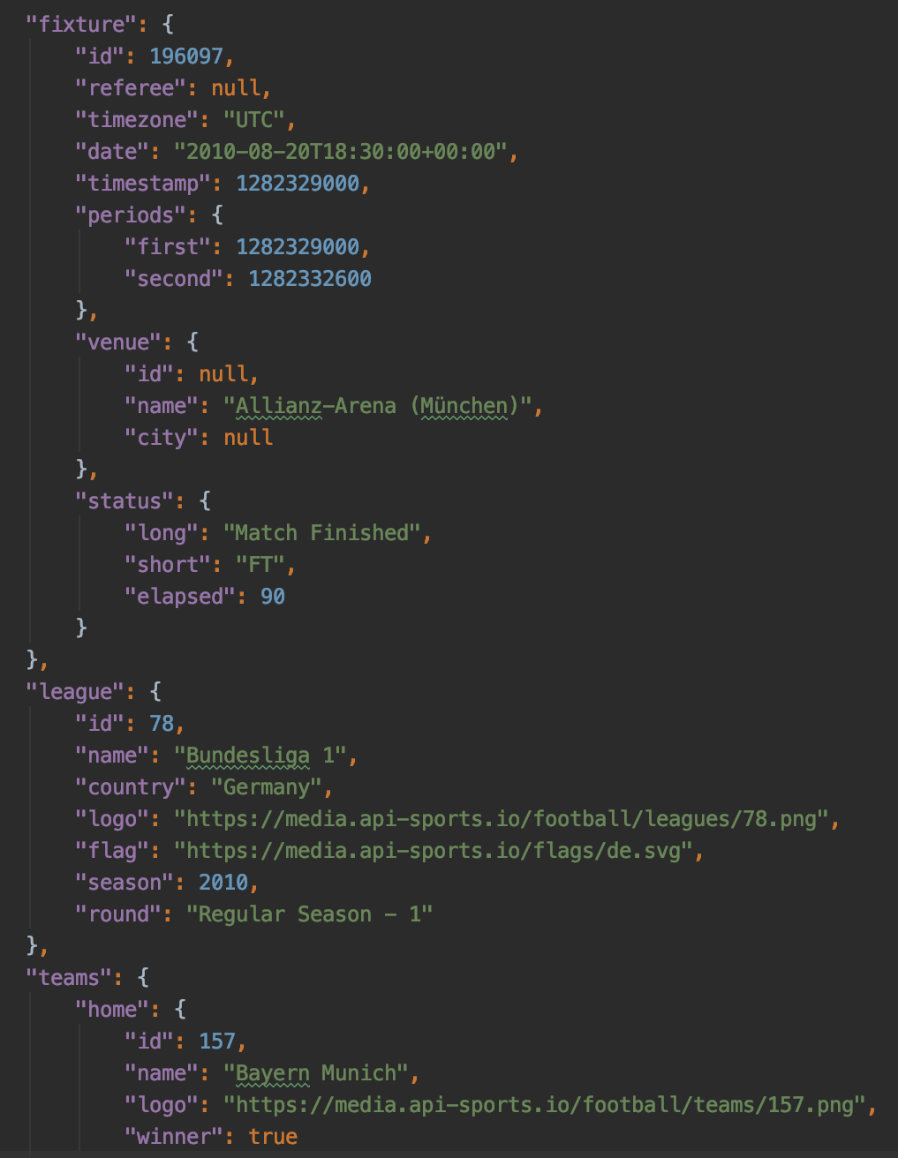
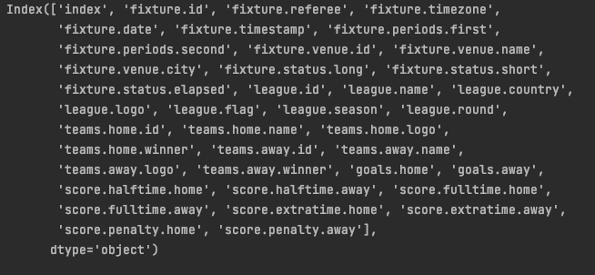
Workflow
AnalysisHelper
.getfixtures
Notes:
What does the workflow look like , it’s pretty simple, here you can see said json format, being converted into a dataframe that looks like this. having a lot of columns as you can see keys right here. And here you can see an example of a dataframe, having over 20k rows, each row is one football game. The dataframe also shows which league, season and the playing teams as well. With that, we could finally start the actual analysis.

Slide 11
03
Results
Anything finalized yet?
Notes:
Now it is time for results. And to answer our research question. And what we did is this:

Slide 12
Questions
How many games won/lost on avg?
How many goals made/conceded at home/ away?
Are there any strays or is the outcome consistent?
Are the years 2020/2021 different from the years before?
How often did the Away goal rule come into play?
Text hinzufügen
Notes:
We took two our questions from our topic proposal: How many games were won/lost on avg? and How many goals made/conceded at home/ away?
And already the first question could be answered in a lot of different ways. That is why everybody in our group took an individual approach.

Slide 13
Questions
How many games won/lost on avg?
Pie Chart → Alex
Barplot for a single league by seasons ( all years ) → Raphael
Barplot over all years and all leagues → Anastasia
How many goals made/conceded at home/ away?
Barplot for teams in a single league by seasons → Florian

Slide 14
Questions
How many games won/lost on avg?
insgesamt prozent -> piechart: sascha
bundesliga: mit x: ligen, y: win%: raphael
over all leagues: x: years, y: win rates: anastasia
How many goals made/conceded at home/ away?
x: teams/liga, y: number/% of home goals: florian 666
Are there any strays or is the outcome consistent?
Are the years 2020/2021 different from the years before?
How often did the Away goal rule come into play?
…

Slide 15
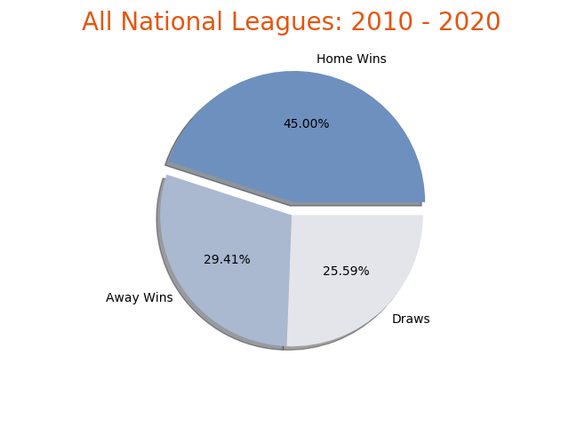
Distribution of Home- and Away-Wins
most important information
measurable Home Advantage
with draws
Notes:
I took on the almighty pie chart which is probably the easiest and most comprehensible approach because it frankly does not tell you alot.
The only numbers are the percentages of the Home-, Away-Wins and the Draws.
But on the other hand it shows the most important information there is in our dataset regarding our topic.
And the simple answer to our question is: there is a quite measurable and stable Home Advantage.
<Description of the pie chart>

Slide 16
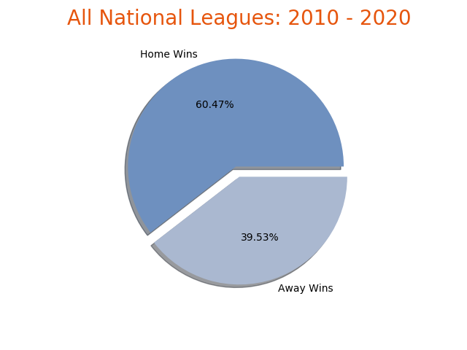
Distribution of Home- and Away-Wins
higher Home Advantage
without draws
Notes:
<Description of the pie chart>
And if we take away the draws there is even much bigger Home Advantage. But this also poses one of the problems that we had with the data.
Is it important to include the draws or would it corrupt the results if we exclude it? Our decision is still pending.

Slide 17
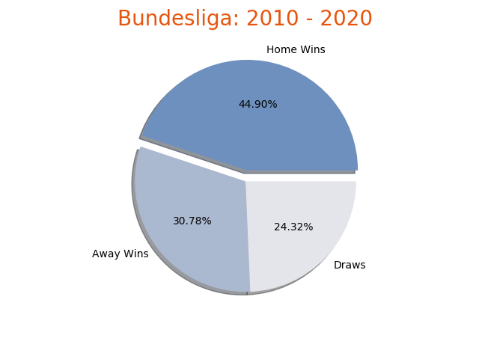
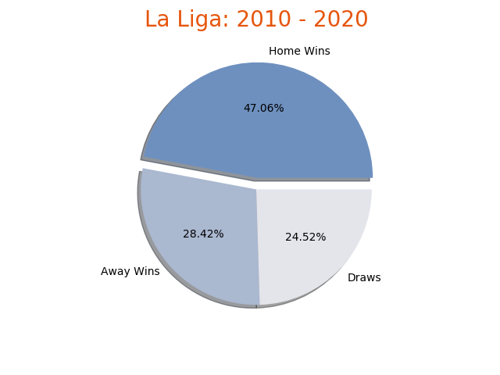
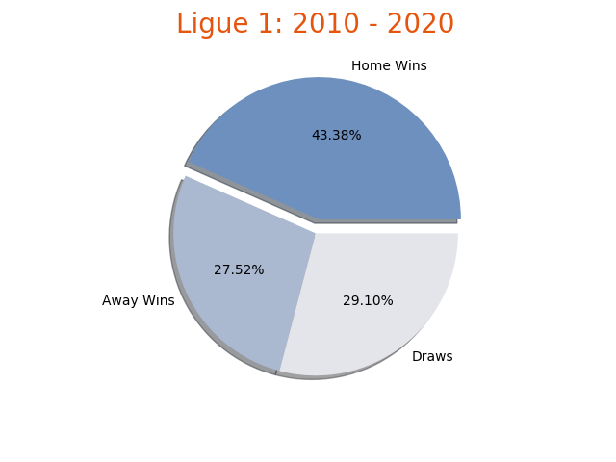
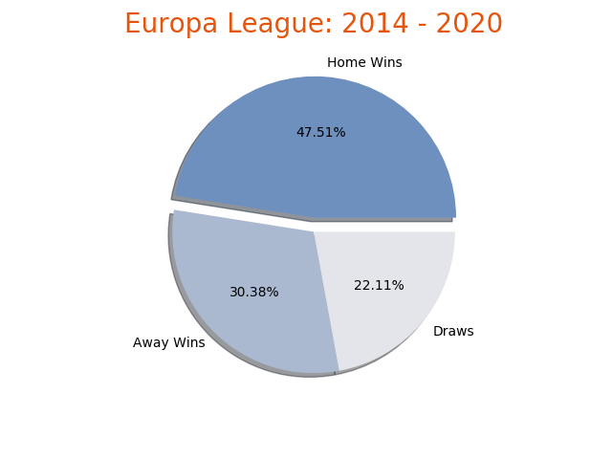
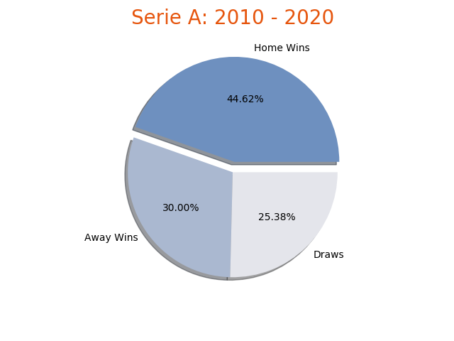
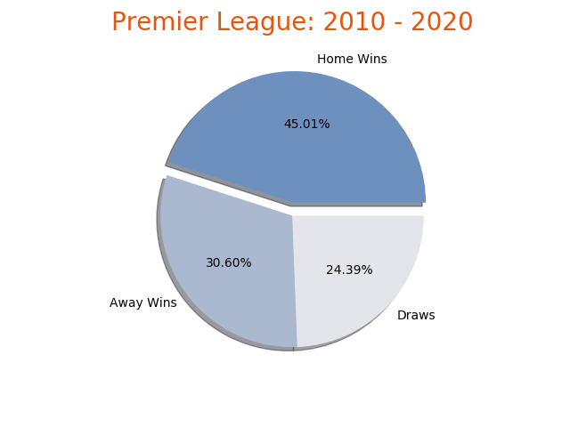
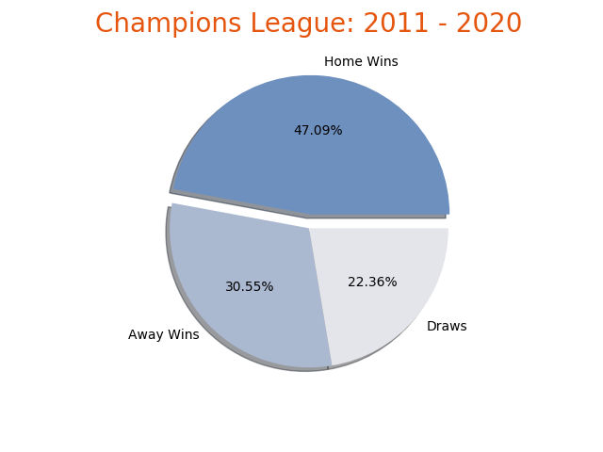
Pie Chart
Notes:
And just to take it on an obvious level I plotted the pie for every league by all season there are available.
By the darkish blue exploded piece you can tell that home advantage is a common product and goes well with the overall result of 45% since the pieces look very similar. No outliers are to be found. In France is the lowest number of 43.38 %. and the Europa League has the highest value with 47.51 %.

Slide 18
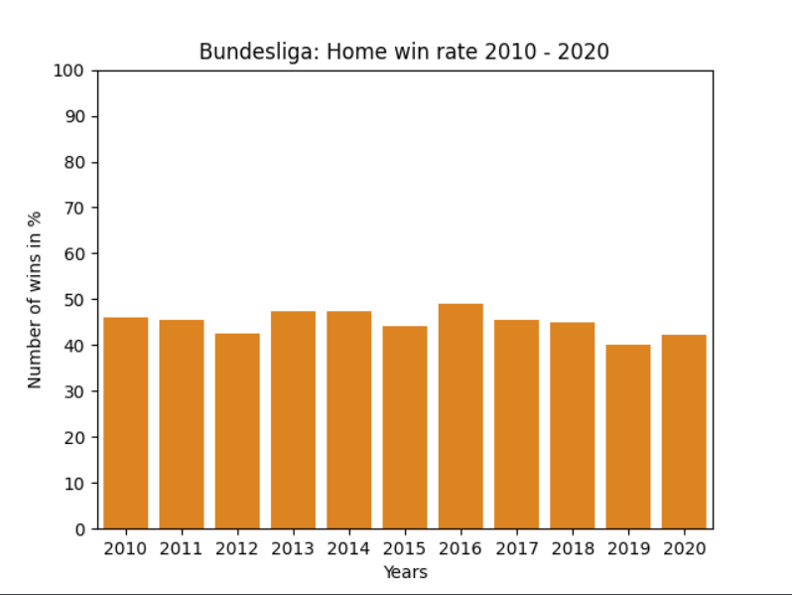
How many games won in average ?
Home win rate for:
Single league by years
home # wins@home
win rate = ( ) * 100
# games
Observations:
below 50%
clumsy and converging
Notes:
another perspective on the general question how many games have been won in average?
we specified it a bit to find the home win rate in the Bundesliga in the years:
2010 till 2020 as you can see on the x achses
and the number of wins made at home in percentage on the the y achses
for example in the season of 2010 we have arounf 45 %
and we calculated this by the formula here:
taking # wins made at home divided by # games in the whole season multipleyd by 100 to get %
we did this all the years
general observation is that:
its always below 50% because keeping in mind that on the other side we have draws and looses
it also looks a bit clumsy and coverging ( similiar )
because of the wide view with the 100% when displaying
lets see how we can make it better

Slide 19
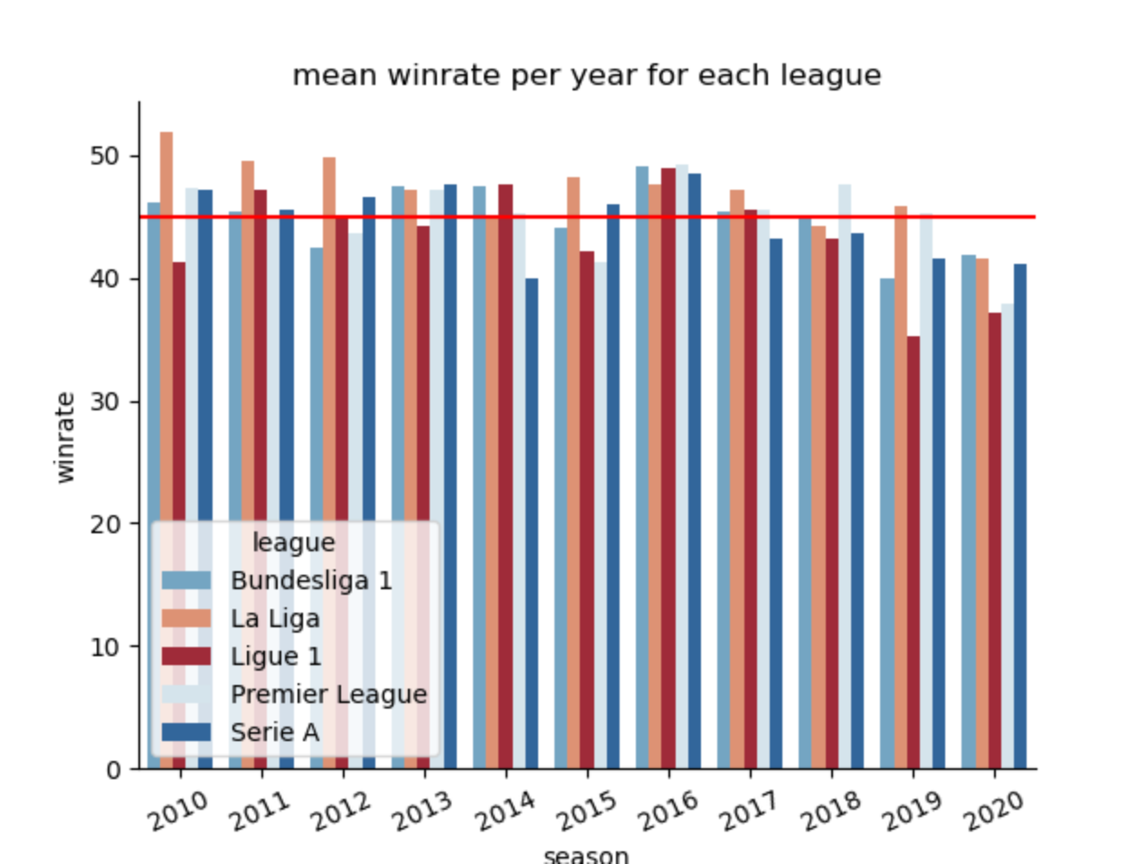
Home win rate for all leagues by years
win rate but:
for each league
for each year
red line → mean over all leagues and years
BUT
not good visualization
Notes:
I had a simmilar approach like raphael, but instead of calculating the win rate for a singe league I calculates it for all leagues and all seasons and this is the resulting bar diagram. you can see the win rate in percetn on the y axis and the years on the x axis and each league has a different colour. I also added the average win rate over all leagues and years. But if you look at this vizualization ist dioesnt look very appealing and you dont know what you should get out of looking at it so i played around a little bit and got the following result
I was responsible for analyzing the home win rate for every year since 2010 and for every league that we look at. For calculating the win rate I counted all the games a league has won each year and then divided that by the number of games that took place that year. As a result I got this bar diagram. on x axis bla on y axis bla on % and each league has a different color. And you can also see a red line. That is the average win rate for all leagues over all seasons and its around 45%. But I see a couple of problems with this visualization. The first thing is that too much is going on and you dont know where to look or what to take from this. You as an audience cannot draw any conclusions regarding win rate from that.
So I played around a little bit and got the following result:

Slide 20
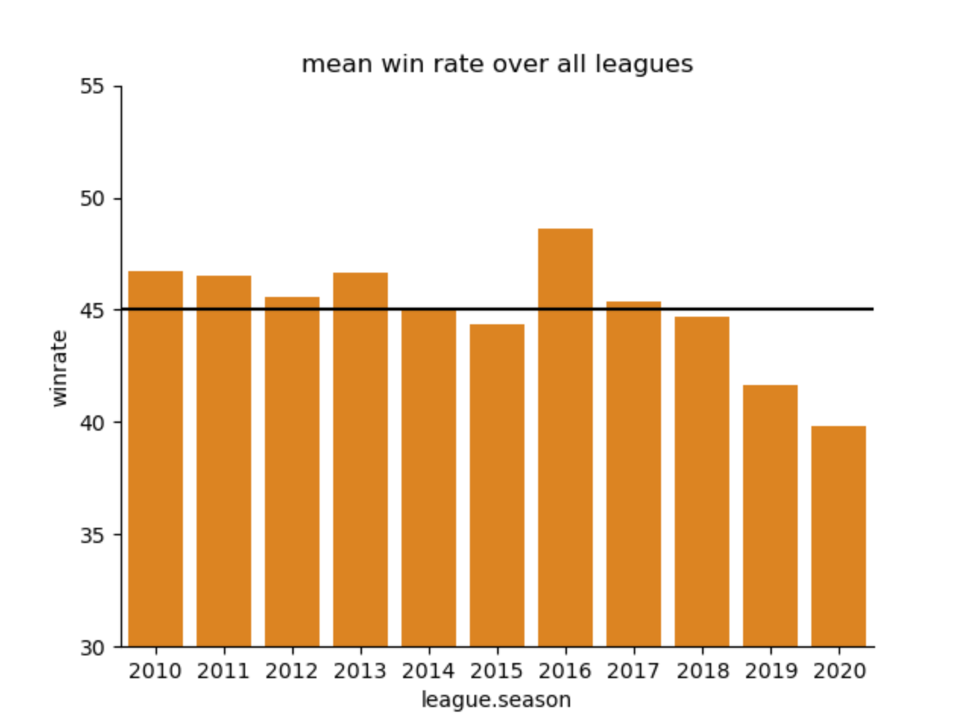
Home win rate for all leagues by years
not divided by league but average win rate in total for each year
adjusted y-axis
clearer visualization
Notes:
In this bar diagram I have calculated the win rate the same way except this time the bars represent the average win rate for all leagues. Another thing I did was adjust the y axis. It now doesnt start from 0 but from 30. This just makes it more easy to see the development. What is immediately noticeable is that the average win rate in 2016 was by far the highest and in 2019 you can see a big drop.

Slide 21
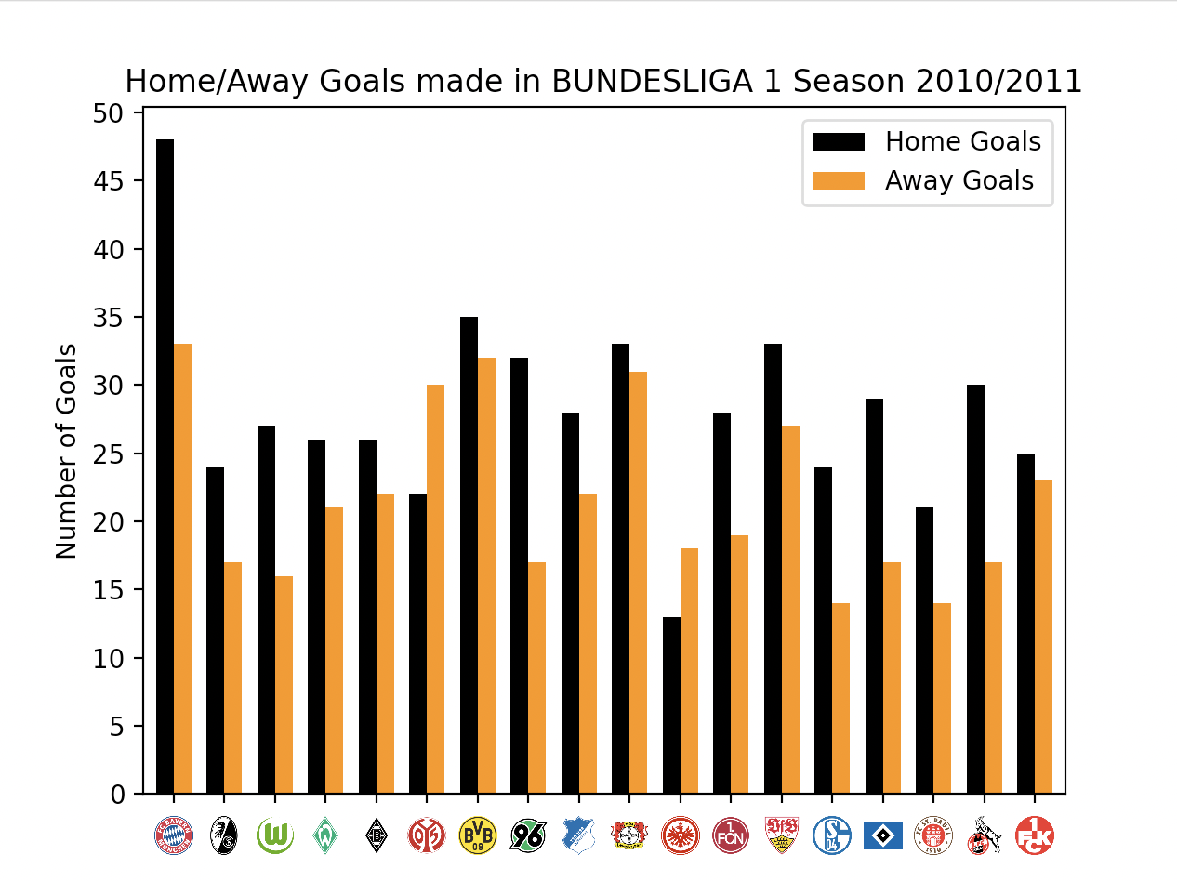
How many goals made/conceded?
How many goals made at home/away?
per season and league - Season 2010/2011
number of home/away goals made for each club
way more goals made at home than away
Notes:
Another interesting question for us was, how many goals do clubs at home make and how many do they make away. As well as how many goals do clubs concede at home and away. Here you can see a graph that shows the number of goals each bundesliga team has made in season 2010/2011. The black bar represents the number of goals at home and the orange one the away goals. you can see clearly that these teams do score more at home than they do away. What about defense, how many goals do teams concede home and away?

Slide 22
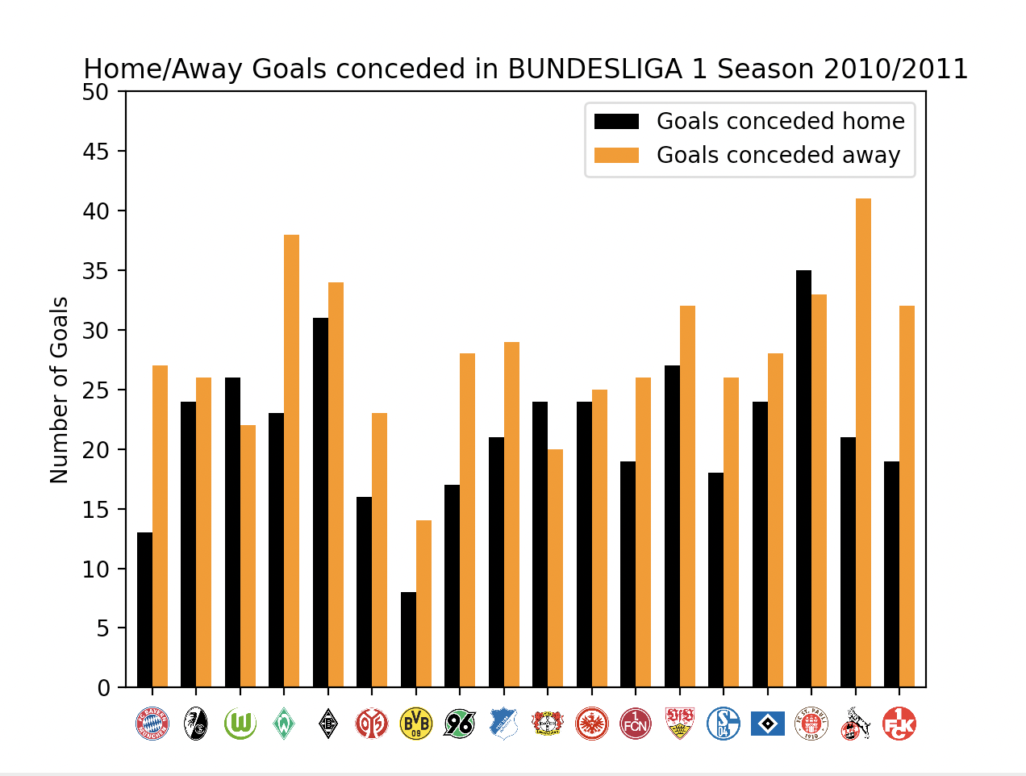
How many goals made/conceded?
How many goals conceded at home/away?
per season and league - Season 2010/2011
number of home/away goals conceded for each club
way more goals conceded away than home
Notes:
In this graph right here the goals conceded are shown.
Having the last slide in mind it is not surprising that these clubs indeed concede more goals away than at home.
But something that we want to focus on in our next steps , in terms of this specific question, is computing the average difference in goals made home/away and difference in goals conceded home/away. We might summarize it to an average for an entire season, and plot the development, to hopefully see a significant change like we kind of did regarding the home win rate within last few years. But thats on to our next steps.

Slide 23
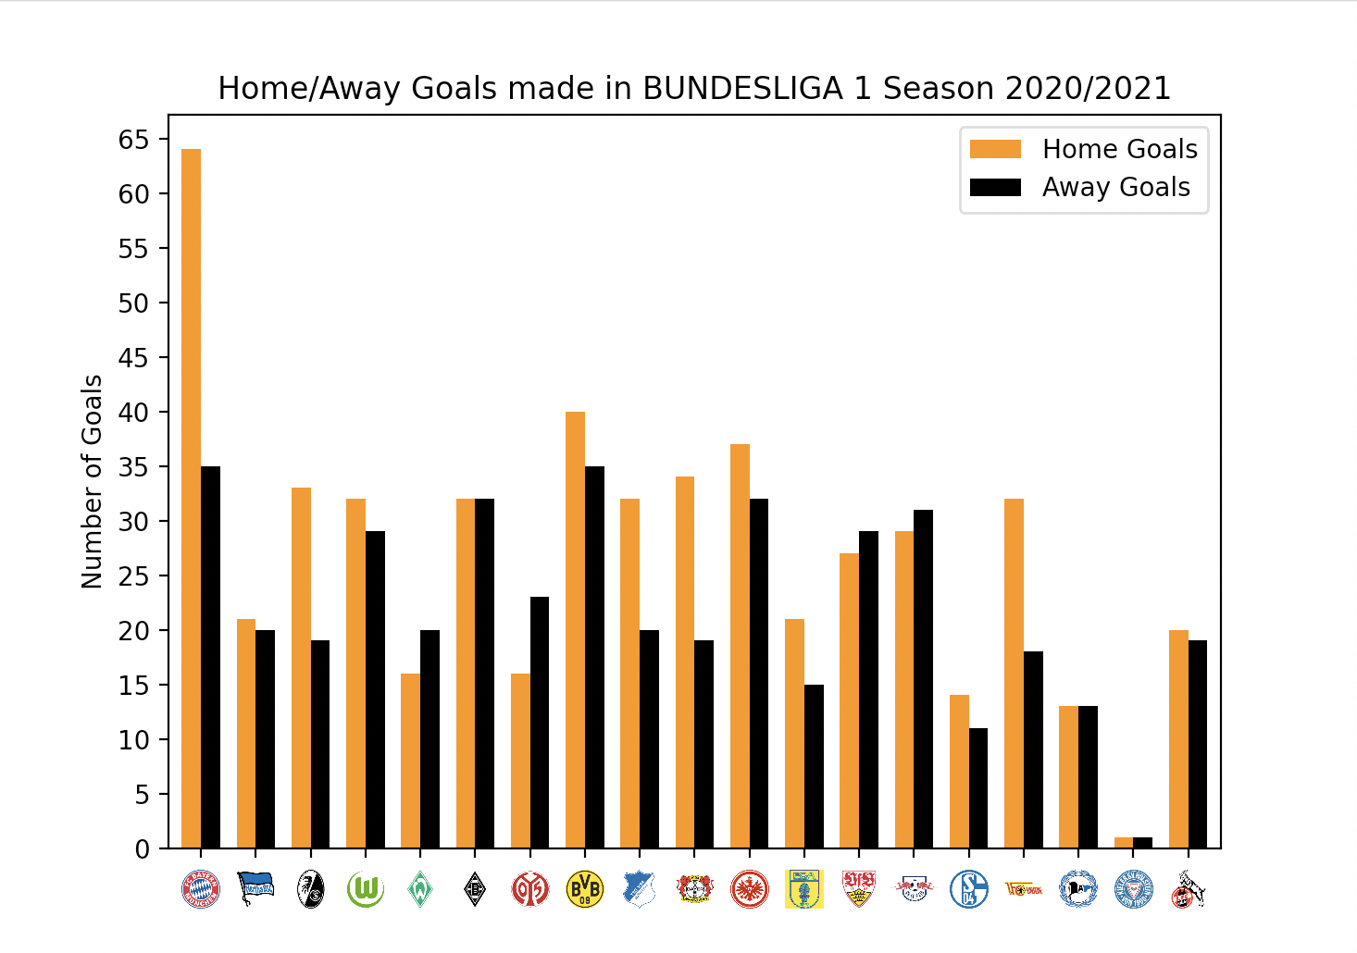
How many goals made/conceded?
How many goals made at home/away?
per season and league - Season 2020/2021
number of home/away goals made for each club
way more goals made at home than away
Notes:
Same plot as in the first slide, just for another season, this time 2020/2021. This time the orange bar represents goals at home and the black bar represents the away goals made. Nothing too much different.

Slide 24
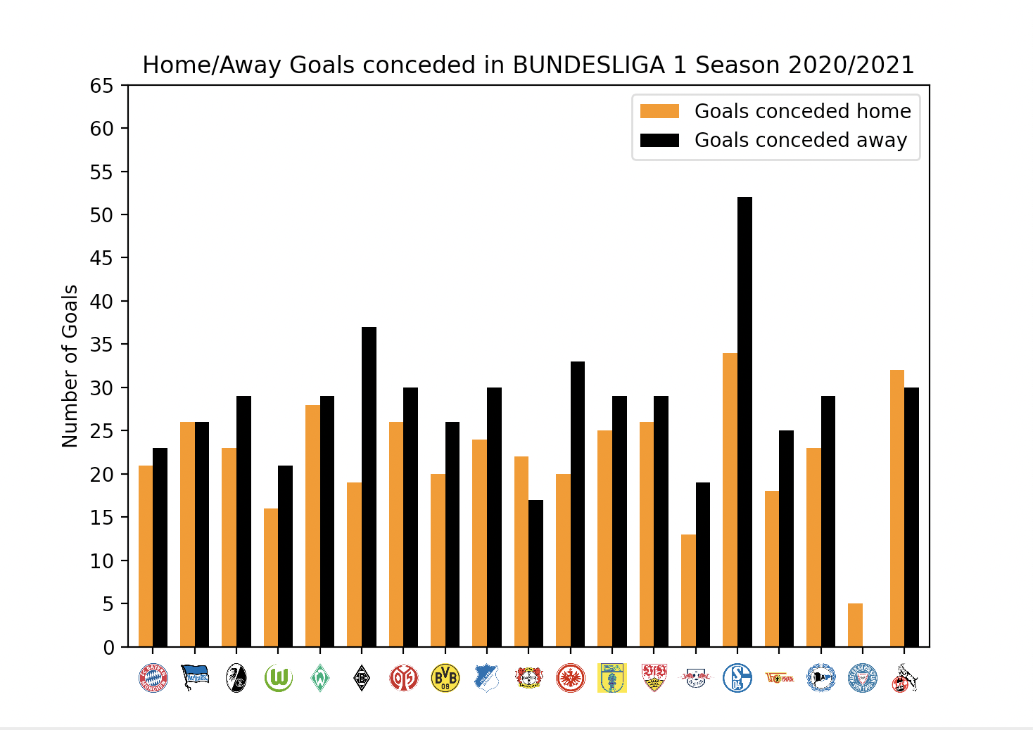
How many goals made/conceded?
How many goals conceded at home/away?
per season and league - Season 2020/2021
number of home/away goals conceded for each club
way more goals conceded away than home
Notes:
The same goes for the plot on the goals conceded. Something that we want to focus on in our next steps, is computing the average difference in goals made home/away and difference in goals conceded home/away. We might summarize it to an average for an entire season, to hopefully see a significant change.

Slide 25
04
Next Steps
What holds the future?
Notes:
Now that we’ve seen what our dataset looks like, we need to use that data to answer our research question. So what exactly are we going to analyse?

Slide 26
Questions, Resume
More questions to tackle?
until now:
→ How many games won / lost on average?
→ How many goals made / conceded at home and away?
Descriptive 2 Inferential
global → more detail
Notes:
until now we tackled these two ain questions from different perspectives
its still a quiete global view and we want to go into more detail
as finding out what happend in 19 an 20 with abolishment of the away goals rule
more questions which ones to tackle?
we approached 2 questions already in different ways, foremost the question: How many games won/lost on avg?
our results are atm very descriptive and we need later more insights into the data -> tell a more detailed story about the data, more analysis, because we just show the data now and don’t have any bigger conclusion
—> go into more detail
improve color palettes, asthetics, visuals, font, legends, own explanation
→ general template coherent style
with draws vs. without draws: … pending
findet hier eine verfälschung statt?
from hater to believer ?

Slide 27
Aesthetics, Draws
General template, coherent style
Pending:
with Draws vs. without Draws
Notes:
also figure out a general template and coherent style for the final presi and report
and the pending questions if we should include the draws in our calculation
because in some papers the
draws are not seen as equal valued to the wins and looses
and it makes a big difference when it comes to visualising and higlighting specific points

Slide 28
Thank You! Any Questions?
Notes:
And that was our proposal presentation. We hope you liked it. Thank you for your attention and are there any questions so far?

Slide 29
Sources
Papers:
(1) Nevill, A.M. and Holder, R.L., 1999. Home advantage in sport. Sports Medicine, 28(4), pp.221-236.
(2) Pollard, R., 2008. Home advantage in football: A current review of an unsolved puzzle. The open sports sciences journal, 1(1).
(3) Carron, A.V., Loughhead, T.M. and Bray, S.R., 2005. The home advantage in sport competitions: Courneya and Carron's (1992) conceptual framework a decade later. Journal of sports sciences, 23(4), pp.395-407.
Pictures:
Slide 4:
Leite, W.S., 2017. Home advantage: Comparison between the major European football leagues. Athens Journal of Sports, 4(1), pp.65-74.
- All screenshots and web sources were taken or visited in 25.01.2022

